Slide 1


IoT Camp
Erica Barone
Technical Evangelist Windows & IoT @_ericabarone erica.barone@microsoft.com
Guenda Sciancalepore
Microsoft
guscianc@microsoft.com
@guenda_s
Emanuele Quacchio
STMicroelectronics
emanuele.quacchio@st.com
Francesco Scullino
MIC Torino - ISMB
v-frscul@microsoft.com
Federico Angaramo
MIC Torino - ISMB
angaramo@ismb.it

Slide 2
Agenda
Morning
Azure IoT Suite, IoT Hub, Stream Analytics
Microsoft Power BI
Cognitive Services
Sensor 2 Cloud
Hands on Lab settings check
Lunch
Afternoon
Hands on Lab

Slide 3
Microsoft Azure IoT
Francesco Scullino
Microsoft Innovation Center Torino

Slide 4
Harnessing the IoT Revolution
What if I simply knew where my things were?
What if my things could tell me when they go someplace they shouldn’t?
What if I could collect data which helps me improve my product?
It all starts with a great idea…
What if I knew when things were going to break before they did?
What insights could I find from comparing all of my things?
What if I could tell when it’s the best time for my things to _______ ?

Slide 5
















IoT solution – architecture
1
2
3
4
5
7
IoT devices and social
Connection
Data Collection
Data Store
Analysis
BI Tools
Machine Learning
Stream Analytics
Data Lake
PowerBI
Storage Blob
Azure Files
Tables
6
Additional Services
IoT Hub
Event Hubs
Azure SQL
DocumentDB
MongoDB
SQL Data Warehouse
Azure Automation
HDInsight
APP
Notes:
Solution flow
Data is collected from apps, smartphone devices, sensors, GPS, and other IoT devices
IoT Hub lets you connect with IoT devices securely and provides IoT Hub identity registry to manage device authentication
Event Hubs streams millions of events per second and makes data available to process and analyze
Data collected from IoT devices can be stored in different types of data stores, including DocumentDB, Azure SQL, Azure SQL Data Warehouse, and MongoDB
Use data analytics services, including Machine Learning, Data Lake Analytics, and Stream Analytics, to analyze large amounts of data collected from IoT devices
Additional Azure services, including Automation, can be used to configure advanced features
Use Power BI, Tableau, or Qlik to visualize data with meaningful insights to identify device usage and user behavior

Slide 6
Azure IoT Suite https://www.azureiotsuite.com/

Slide 7

IoT projects can be complex
Difficult to maintain cohesive security
Time-consuming to stand up
Incompatible with current infrastructure
Hard to scale

Slide 8

Azure IoT Suite
Device Connectivity & Management
Data Ingestion and Command & Control
Stream Processing & Predictive Analytics
Workflow Automation and Integration
Dashboards and Visualization
Preconfigured Solutions
Remote Monitoring
Predictive Maintenance

Slide 9
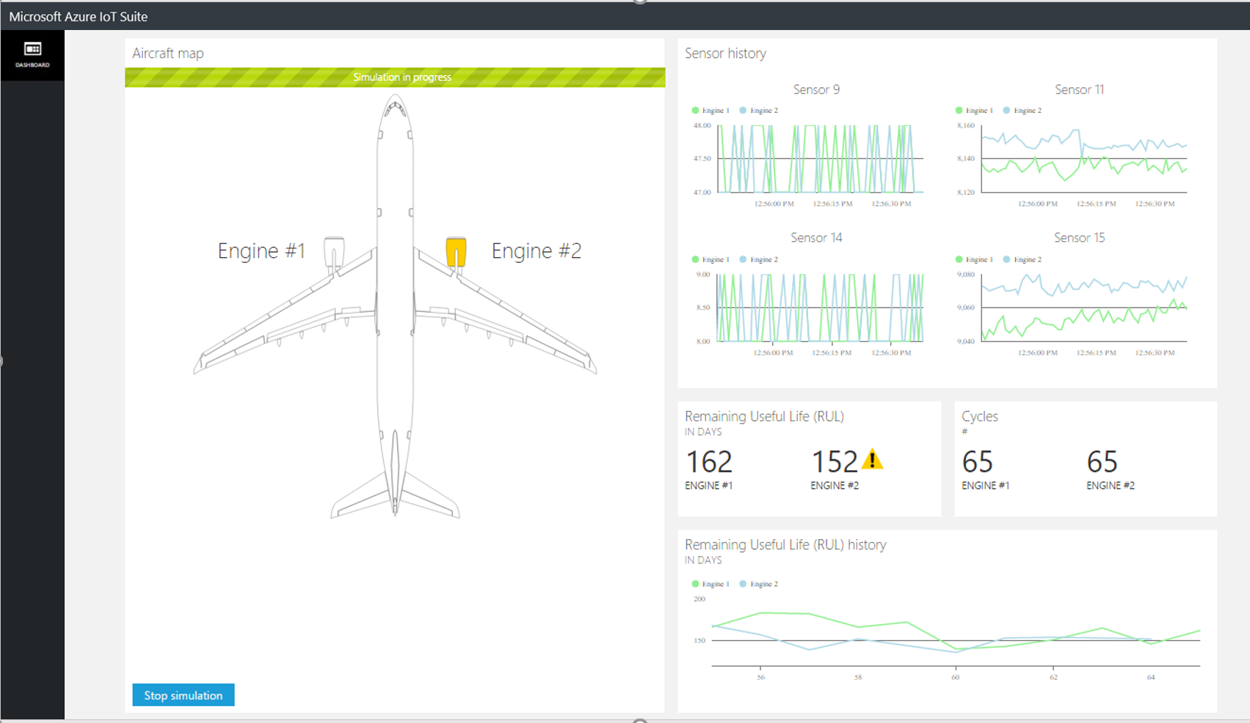
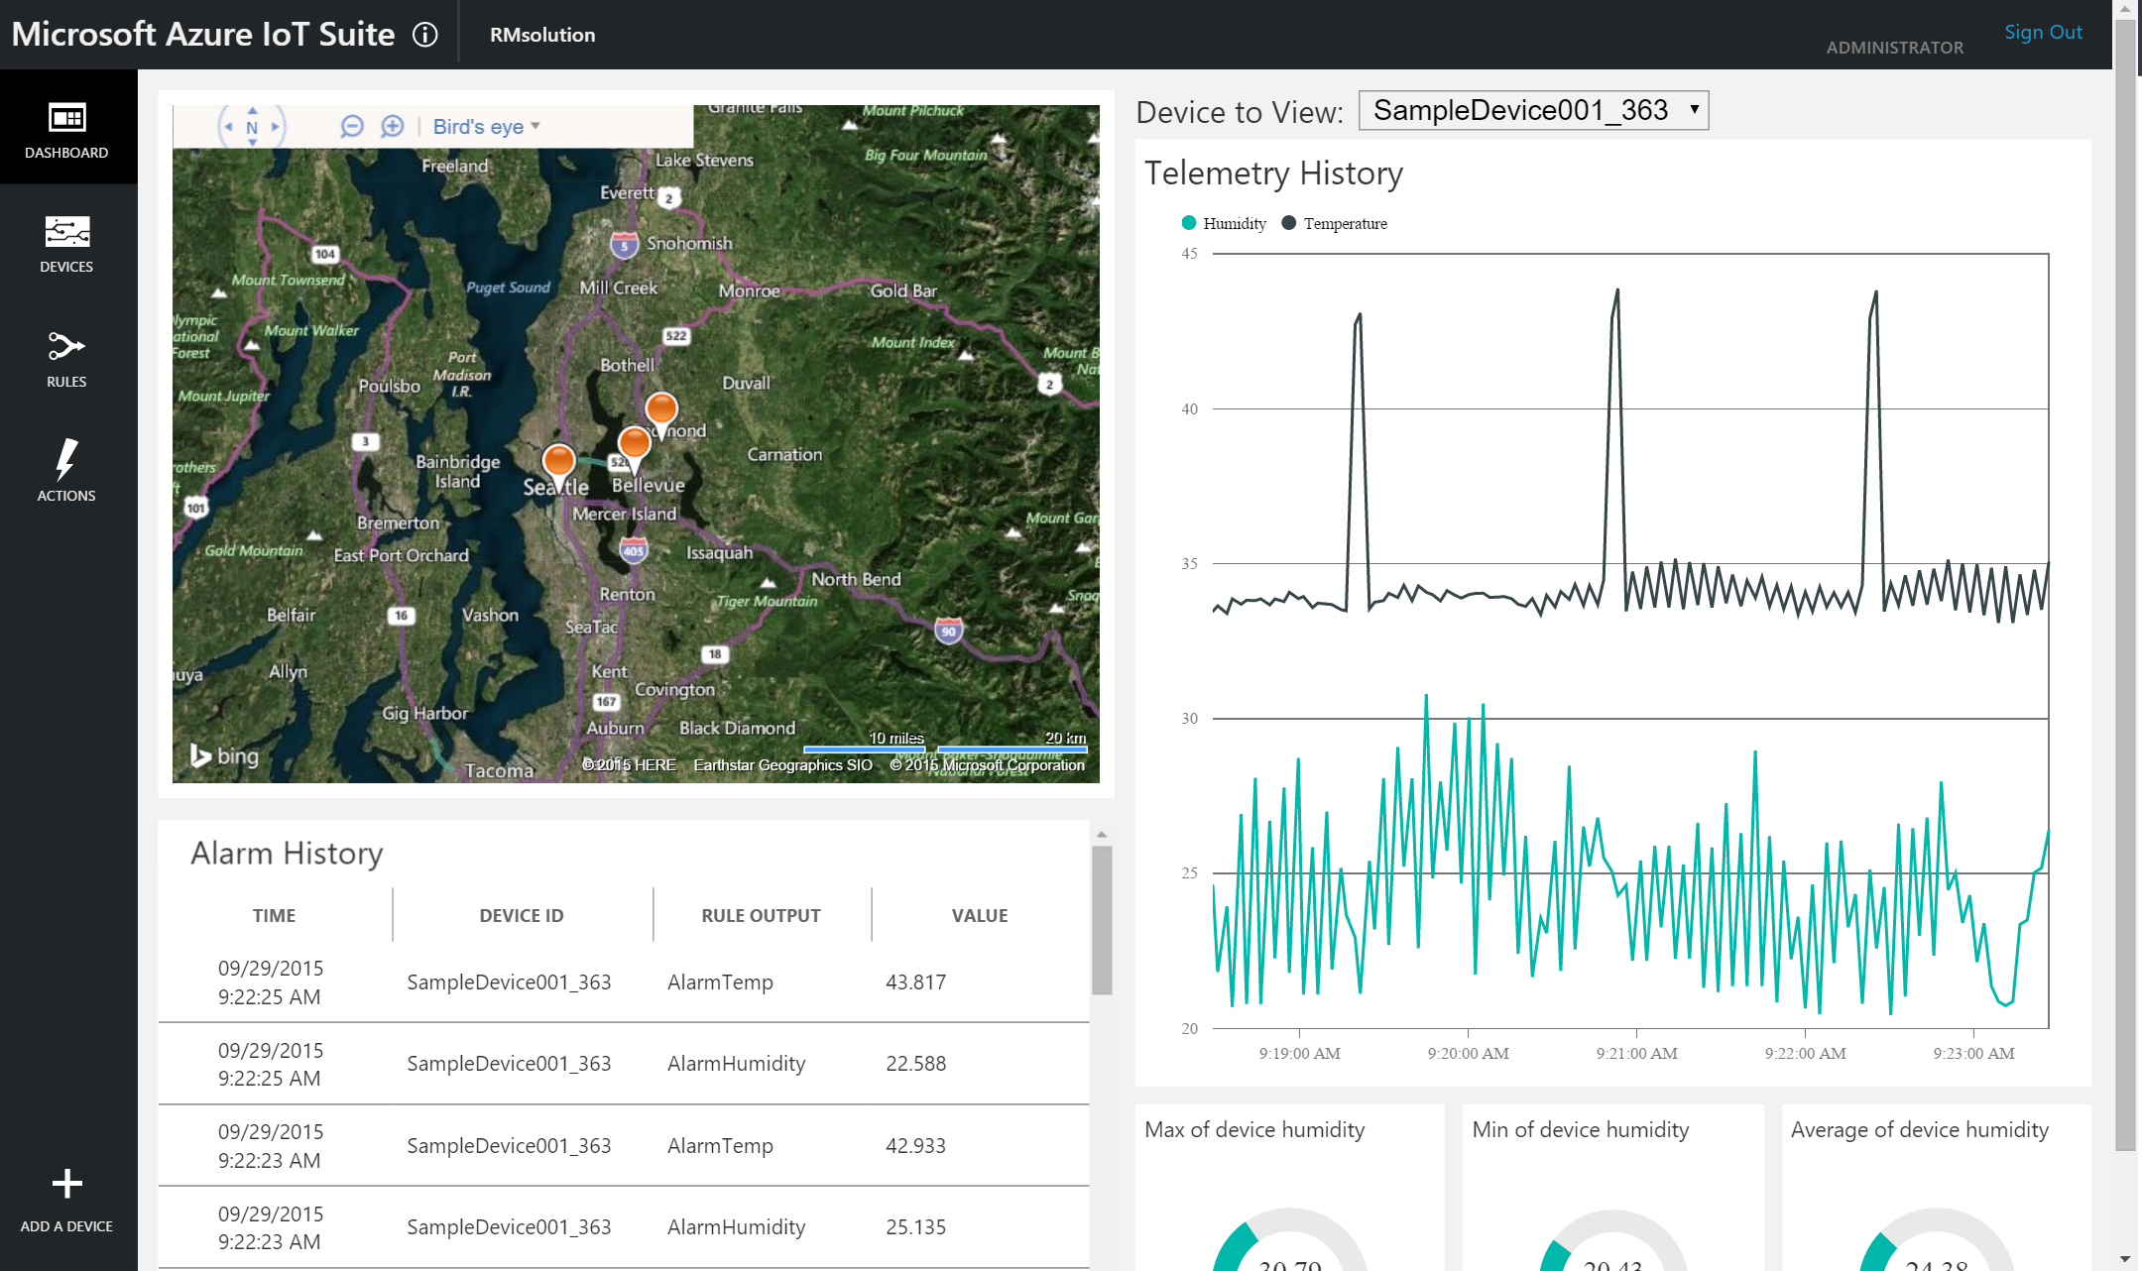
Preconfigured Solutions
Remote
Monitoring
Predictive
Maintenance
More to come…

Slide 10
What you get with remote monitoring preconfigured solution
Devices
Azure IoT Suite Remote Monitoring
Back end systems and processes
Web/ Mobile App
Storage blobs
DocumentDB
C# simulator
IoT Hub
Stream Analytics
Event Hub
Web Jobs
Logic Apps

Slide 11
Azure IoT Hub

Slide 12
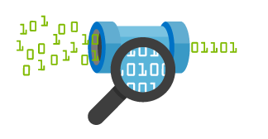

Azure IoT
IoT Hub
Event processing and insight
(e.g. hot and cold paths)
IP-capable
Cloud protocol
gateway
Field gateway
Device business logic,
Connectivity monitoring
PAN-devices
Application
device provisioning and management
field
cloud

Slide 13
Azure IoT Hub
Designed for IoT
Connect millions of devices
Security
X.509 via AMQPS/HTTPS
Use IoT Hub to enable secure bi-directional comms
Cloud-scale messaging
Device-to-cloud and Cloud-to-device
Durable messages (at least once semantics)
File upload support in portal
Cloud-facing feedback
Delivery receipts, expired messages
Device communication errors
Per-device authentication
Individual device identities and credentials
Connection multiplexing
Single device-cloud connection for all communications (C2D, D2C)
Multi-protocol
Natively supports AMQP, HTTP, MQTT
Designed for extensibility to custom protocols
AMQP over WebSocket
Multi-platform
Device SDKs available for multiple platforms (e.g. RTOS, Linux, Windows, iOS, Android)
Multi-platform Service SDK.

Slide 14
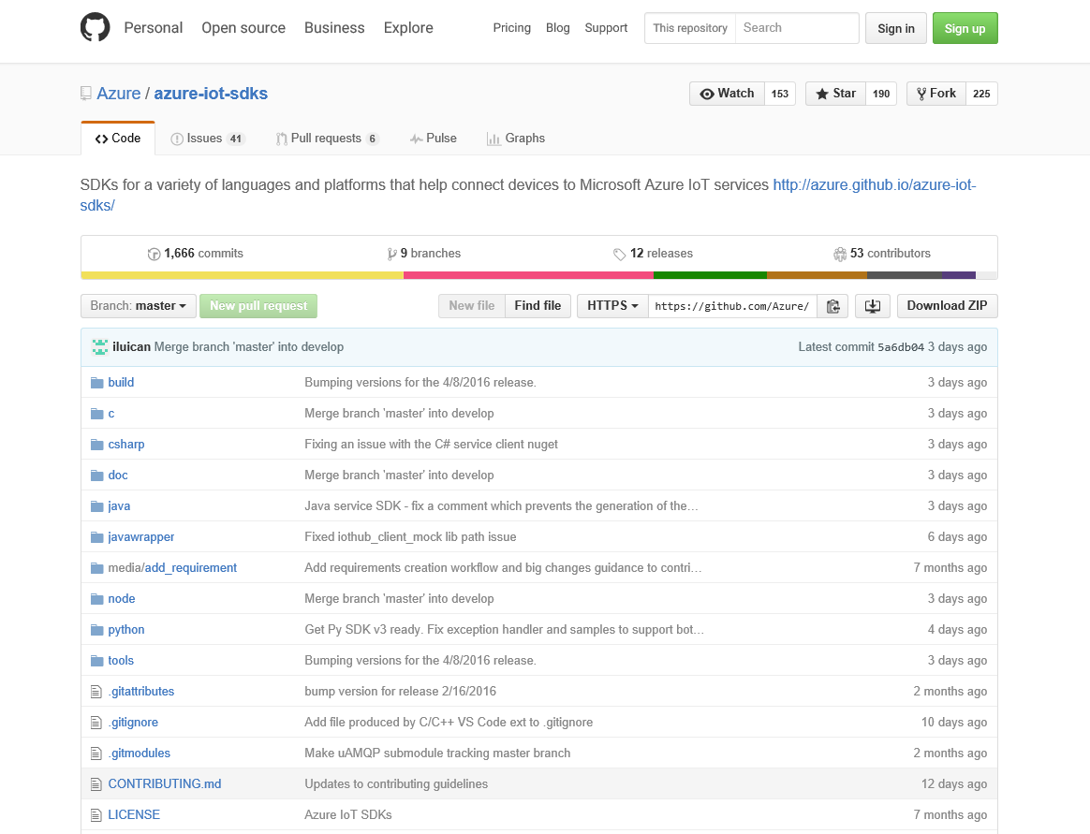
Azure IoT Suite SDKs
Device-facing
For devices and field gateway
Platforms
RTOS (FreeRTOS)
Linux (Ubuntu, Debian, Fedora, Raspbian, Angstrom)
Windows 7/8/10
ARM mbed
Android
iOS
…
Languages
C, Java, C#, Node.js, Python
Service-facing
For back-ends and cloud gateway
Languages
.NET C#
Java
Node.js
https://github.com/Azure/azure-iot-sdks

Slide 15
IoT Hub endpoints
Your IoT Hub
Event processing
(hot and cold path)
device
Device id
D2C receive endpoint
D2C send endpoint
Device business logic,
Connectivity monitoring
C2D queue
endpoint
C2D send endpoint
Field GW /
Cloud GW
Msg feedback and monitoring endpoint
Device …
Device …
Device provisioning and management
Device identity management
Device …
IoT Hub management
Notes:
IoT Hub exposes a set of conceptual endpoints to access its functionalities.
There are two endpoints for each device: one to send D2C msgs, one to receive C2D msgs.
Devices can connect two both endpoints over the same connection.
FGW and CGW are able to represent multiple devices by simultaneously connecting to D2C and C2D endpoints for many devices at the same time.
On the app back-end side, the D2C receive endpoint is used by the event processing pipeline (ASA, Storm, custom, …), and by the device runtime logic component, which handles requests and command responses that come from devices.
The device runtime logic component also uses the C2D send endpoint to send notifications and commands to devices.
It also uses the msg feedback and monitoring endpoint. This is critical for IoT solutions where devices are reachable only through IoT Hub. In these very common scenarios, any problem on the connectivity between device and IoT Hub cannot just be reported as errors back to the device, but also to the app back-end in the form of events on this feedback endpoint. This makes possible the kind of monitoring that is required to achieve high operability of an IoT solution.
In addition to these runtime endpoint, IoT Hub also has a device identity mgmt endpoint that is used by your solution’s device provisioning and mgmt component.
Finally, an IoT Hub Manage endpoint is used to set security, functional, performance parameters.

Slide 16
Security
Permissions
DeviceConnect – for any component connecting as a device (e.g. send D2C, receive C2D, …)
ServiceConnect – for back-end components (e.g. read D2C, send C2D, receive feedback/monitoring)
RegistryRead – for provisioning components that have to read the hub’s device identity registry
RegistryWrite – for provisioning components that have to modify the hub’s identity registry
Authorization policies
Each hub allows multiple policies
Each policy grants a set of permissions
Primary and Secondary keys
Shared Access Signature
SharedAccessSignature sig={signature}&se={expiry}&skn={policyName}&sr={URL-encoded-resourceURI}
Sig = An HMAC-SHA256 signature string of the form: {URL-encoded-resourceURI} + "\n" + expiry
resourceUri: /devices/{deviceId}; /devices/{deviceId}/events; /events

Slide 17
Azure IoT Hub device management
Device twin: firmware version, battery level, and connected state. Organize devices by tags
Device query: aggregate view of device twins
Device jobs: firmware update, reboot, factory reset

Slide 18
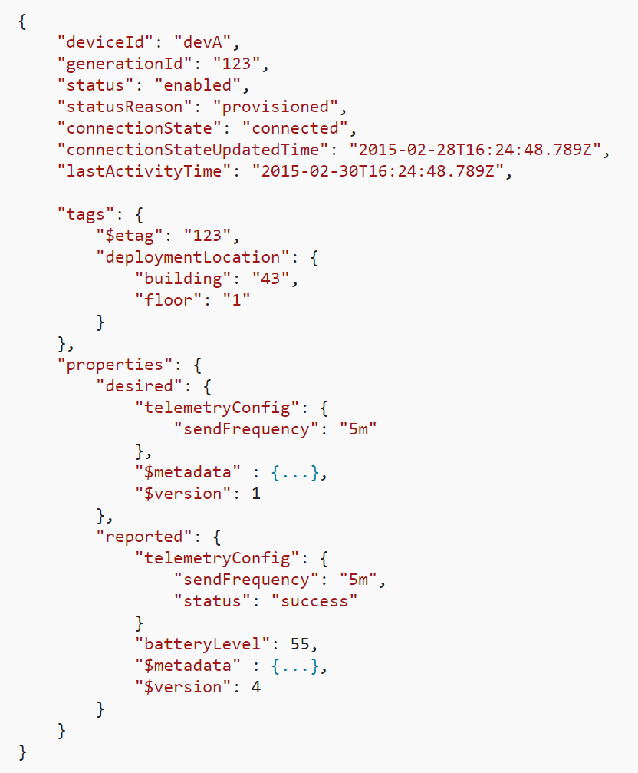
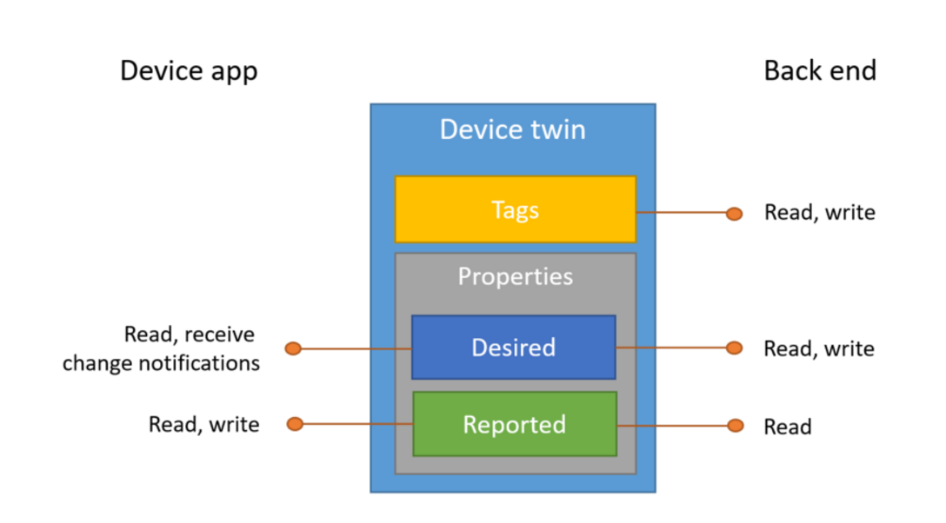
Device twin

Slide 19
Azure Stream Analytics

Slide 20
Real time event processing
Uncover real time insights
Perform real time analytics across multiple streams
Rapid Deployment
Use simple SQL syntax, auto distributed for scale
Mission critical reliability
Fully managed, low latency, high throughput
Create real time alerts
Flag alerts and alarms for attention
High volume
Analyze millions of data points per second
Highly scalable
Enterprise grade, predictable solution.
Notes:
ASA can not only handle millions of events per second but it can also correlate across multiple independent streams of data simultaneously. This high speed event processing allows for the real time detection of anomalies or escalations based on threshold breaches or alarm settings as the data is ingested. The architecture is simple and easily scalable to an enterprise ready solution.
Azure Stream Analytics:
Real time analytics
Millions of events per second
Low latency, high througput

Slide 21

Application Components
Components of an Azure Stream Analytics Application
INPUT
Source of Events
OUTPUT
[Result of Query]
Stream Analytics Query
Azure IoT Hub
Azure SQL DB
Events
Have a defined schema and are temporal (sequenced in time)
Azure Blob Storage
Azure Blob Storage
Azure Event Hubs
Reference Data
Query runs continuously against incoming stream of events
Notes:
abbiamo già detto di che cosa di tratta il servizio di ASA. Vediamo però come funziona.
In particolare, può essere configurato andando a specificare 3 elementi:
INPUT: sorgenti degli eventi. Le sorgenti vere e proprie sono i dispositivi e i sensori che fanno parte dello scenario IOT, però il servizio di ASA non è connesso direttamente a questi, ma è ottimizzato per ricevere input sia da IoT Hub che dal BLOB storage (questo serve per i dati storici, nel caso in cui si volesse cfr il flusso dati realtime con lo storico)
QUERY: implementano la logica di analisi dei dati. Sono scritte in un liguaggio molto simile all’SQL, ma a differenza delle query che vengono effettuate su un DB tradizionale queste vengono eseguite continuamente sullo streaming dei dati
OUTPUT: il risultato dell’esecuzione della query. Deve essere memorizzati in un servizio di gestione dei dati, oppure possono essere inviati ad altri servizi per effettuare ulteriori analisi.
NB: con ASA possono essere effettuate delle elaborazioni anche molto complesse dei dati, non solo filtri sui dati, ma anche correlazioni e aggregazioni dei dati (finestra temporale) e analisi comparative per cfr dati storici con i dati realtime. Inoltre è possibile definire dei pattern all’interno dei flussi di dati.
è in grado di gestire un flusso di eventi fino a 1GB/S, l’integrazione con EH permette di gestire un flusso di milioni di eventi/sec. Inoltre la scalabilità di ASA è automatica e dipende dal tasso di ingresso dei dati, dalla complessità del processo e dai tempi di latenza attesi, in modo da fornire un workload adeguato all’utente.

Slide 22
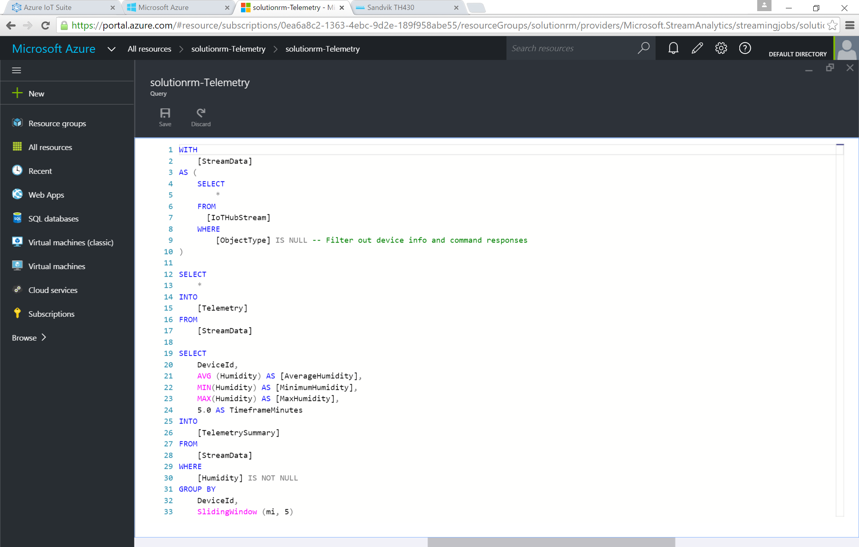
Add or edit jobs using simple ASA interface
Rule based interface
Simple implementation and rule development using ASA UI.
Multi-channel
Analyze multiple channels of information simultaneously, in real time.
Notes:
Utilize the simple ASA rule based interface within the Azure Management Portal to create, manage and control rules.
Azure Stream Analytics:
Simple interface for rule development and management

Slide 23
Query Language - Overview
DML Statements
SELECT
FROM
WHERE
GROUP BY
HAVING
CASE
JOIN
UNION
Date and Time Functions
DATENAME
DATEPART
DAY
MONTH
YEAR
DATETIMEFROMPARTS
DATEDIFF
DATADD
Aggregate Functions
SUM
COUNT
AVG
MIN
MAX
Scaling Functions
WITH
PARTITION BY
Statistical Functions
VAR
VARP
STDEV
STDEVP
Windowing Extensions
Tumbling Window
Hopping Window
Sliding Window
Duration
String Functions
LEN
CONCAT
CHARINDEX
SUBSTRING
PATINDEX
Notes:
Speaker Notes:
Mention that this slide provides an at-a-glance overview of the query capabilities of the SA query language. As noted earlier while some/most of the operators are vanilla T-SQL capabilities there are some features specific to analysis of streaming data such as the Windowing Extensions, scaling functions, DATEDIFF etc.
The subsequent slides will go into these functions in greater detail.

Slide 24
Windowing Concepts
Windowing is a core requirement for streaming analytic applications
Common requirement to perform some set-based operation (count, aggregation etc) over events that arrive within a specified period of time
Azure Stream Analytics supports three types of windows: Hopping, Sliding and Tumbling
Every window operation outputs events at the end of the window
The output of the window will be single event based on the aggregate function used. The event will have the time stamp of the window
All windows have a fixed length
All windows should be used in a GROUP BY clause
Event arrive at different times i.e. have unique timestamps
Events arrive at different rates (events/sec).
In any given period of time there may be 0, 1 or more events
Window 1
Window 2
Window 3
1
5
4
6
2
8
6
4
Time
t1
t2
t3
t4
t5
t6
Aggregate
Function (Sum)
Output Events
18
14
Notes:
Windowing (extensions to T-SQL)
In applications that process real-time events, a common requirement is to perform some set-based computation (aggregation) or other operations over subsets of events that fall within some period of time. Because the concept of time is a fundamental necessity to complex event-processing systems, it’s important to have a simple way to work with the time component of query logic in the system. In ASA, these subsets of events are defined through windows to represent groupings by time. A window contains event data along a timeline and enables you to perform various operations against the events within that window. For example, you may want to sum the values of payload field. Every window operation outputs event at the end of the window. The windows of ASA are closed at the window start time and open at the window end time. For example, if you have a 5 minute window from 12:00 AM to 12:05 AM all events with timestamp greater than 12:00 AM and up to timestamp 12:05 AM inclusive will be included within this window. The output of the window will be a single event based on the aggregate function used with a timestamp equal to the window end time. The timestamp of the output event of the window can be projected in the SELECT statement using the System.Timestamp property using an alias. Every window automatically aligns itself to the zeroth hour. For example, a 5 minute tumbling window will align itself to (12:00-12:05] , (12:05-12:10], …
Note: All windows should be used in a GROUP BY clause.
In the example, the SUM of the events in first Window = 1+5+4+6+2 = 18.
Currently all window types are of fixed width (fixed interval)

Slide 25
Tumbling Window
A 20-second Tumbling Window
Tumbling windows:
Repeat
Are non-overlapping
1
5
4
6
2
8
6
5
3
6
1
0
10
20
30
40
50
60
Time
(secs)
An event can belong to only one tumbling window
1
5
4
6
2
Query: Count the total number of vehicles entering each toll booth every interval of 20 seconds.
8
6
5
3
6
1
SELECT TollId, COUNT(*)
FROM EntryStream TIMESTAMP BY EntryTime
GROUP BY TollId, TumblingWindow(second, 20)
Notes:
Tumbling windows specify a repeating, non-overlapping time interval of a fixed size.
Syntax: TUMBLINGWINDOW(timeunit, windowsize)
Timeunit – day, hour, minute, second, millisecond, microsecond, nanosecond.
Windowsize – a bigInteger that described the size (width) of a window.
Note that because tumbling windows are non-overlapping each event can only belong to one tumbling window.
The query just counts the numbers of vehicles passing the toll station every 20 seconds, grouped by Toll Id.

Slide 26
Hopping Window
A 20-second Hopping Window with a 10 second “Hop”
Hopping windows:
Repeat
Can overlap
Hop forward in time by a fixed period
Same as tumbling window if hop size = window size
Events can belong to more than one hopping window
1
5
4
6
2
8
6
5
3
6
1
0
10
20
30
40
50
60
Time
(secs)
1
5
4
6
2
4
6
2
8
6
QUERY: Count the number of vehicles entering each toll booth every interval of 20 seconds; update results every 10 seconds
8
6
5
3
5
3
6
1
SELECT TollId, COUNT(*)
FROM EntryStream TIMESTAMP BY EntryTime
GROUP BY TollId, HoppingWindow (second, 20,10)
Notes:
To get a finer granularity of time, we can use a generalized version of tumbling window, called Hopping Window. Hopping windows are windows that "hop" forward in time by a fixed period. The window is defined by two time spans: the hop size H and the window size S. For every H time unit, a new window of size S is created. The tumbling window is a special case of a hopping window where the hop size is equal to the window size.
Syntax
HOPPINGWINDOW ( timeunit , windowsize , hopsize )
HOPPINGWINDOW ( Duration( timeunit , windowsize ) , Hop (timeunit , windowsize )
Note: The Hopping Window can be used in the above two ways. If the windowsize and the hopsize has the same timeunit, you can use it without the Duration and Hop functions.
The Duration function can also be used with other types of windows to specify the window size

Slide 27
Sliding Window
Sliding window:
Continuously moves forward by an € (epsilon)
Produces an output only during the occurrence of an event
Every windows will have at least one event
Events can belong to more than one sliding window
A 20-second Sliding Window
1
5
9
8
0
10
20
30
40
50
Time
(secs)
1
5
1
Query: Find all the toll booths which have served more than 10 vehicles in the last 20 seconds
5
1
9
8
SELECT TollId, Count(*)
FROM EntryStream ES
GROUP BY TollId, SlidingWindow (second, 20)
HAVING Count(*) > 10
Notes:
A Sliding window is a fixed length window which moves forward by an (€) epsilon and produces an output only during the occurrence of an event. An epsilon is one hundredth of a nanosecond.
Syntax
SLIDINGWINDOW ( timeunit , windowsize )
SLIDINGWINDOW(DURATION(timeunit, windowsize), Hop(timeunit, windowsize))

Slide 28
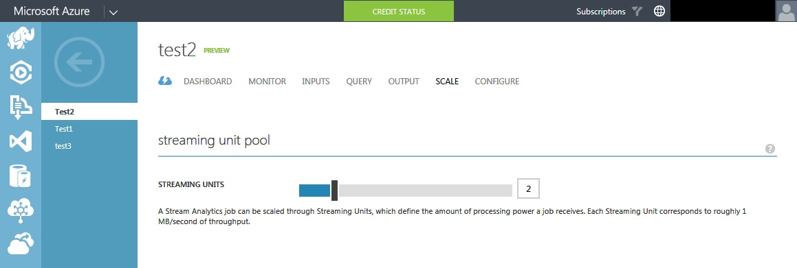
Scaling Concepts – Streaming Unit
Is a measure of the computing resource available for processing a Job
Each streaming unit provides up to 1 MB/second throughput.
Each job needs a minimum of one streaming unit (default)
Number of Streaming Units required for a job depends on:
rate of incoming events
complexity of the query
Total number of streaming units that can be used by a Stream Analytics job depends on:
number of steps in the query defined for the job and
number of partitions for each step.
Notes:
The resource available for processing Stream Analytics jobs is measured by Streaming Unit. Each streaming unit can provide up to 1 MB/second throughput. Each job needs a minimum of one streaming unit, which is the default for all jobs. You can allocate up to 12 streaming units for a Stream Analytics job using the Azure Management portal.
The number of streaming units that your need for a job depends on the expected performance. The performance depends on the rate at which the events are arriving (events per second), the size of the events (bytes/sec) and the complexity of the query. Allocating more streaming units can improve the performance of the query i.e. the number of events it can process. The number of streaming units that can be consumed by a job depends on the number of steps and the number of partitions. An un-partitioned step can only consume 12 streaming units.
Note that streaming units cost money … so be careful with how many streaming unit you allocate.

Slide 29
Questions?

Slide 30

© 2015 Microsoft Corporation. All rights reserved. Microsoft, Windows, Windows Vista and other product names are or may be registered trademarks and/or trademarks in the U.S. and/or other countries.
The information herein is for informational purposes only and represents the current view of Microsoft Corporation as of the date of this presentation. Because Microsoft must respond to changing market
conditions, it should not be interpreted to be a commitment on the part of Microsoft, and Microsoft cannot guarantee the accuracy of any information provided after the date of this presentation.
MICROSOFT MAKES NO WARRANTIES, EXPRESS, IMPLIED OR STATUTORY, AS TO THE INFORMATION IN THIS PRESENTATION.

